Slide 1

Keeping a Design Notebook

Slide 2

Individual Documentation: Notebook
Record of your individual work
All work should be in or referenced in your notebook
  Actual entries
  References to other documentation
Notebook is your thinkpad
  Record thoughts, ideas, research, etc.

Slide 3
Individual Documentation: Notebook Mechanics
Bound, composition style notebook
  Spiral bound notebooks are not acceptable
  All first semester students should have received one at first lecture
Include name, email, phone number and team name on the front cover
All entries should be in ink
Tape, staple, or glue any sheets that you want to include in the notebook
  Referencing is better

Slide 4
Individual Documentation: Notebook Mechanics
All pages must be numbered
  Good idea to keep a table of contents
Sign and date each entry
Cross out any large amounts of blank space
DO NOT erase or remove any pages from the notebook
  If you make a mistake, simply cross it out

Slide 5
Individual Documentation: Notebook Mechanics
Entry Format:
  Title
  Date and time
  Duration
  Who was present
  Location
  Objective
  Procedure
  Results
  Conclusions
  Reflections

Slide 6
Individual Documentation: Notebook Content
Everything that you do should be documented in your notebook
  Pertinent information from lectures
  Lab meetings (agendas, minutes)
  Contact list
  Individual work

Slide 7
Individual Documentation: Notebook Content
Record any thoughts you may have about your project, no matter how strange it may seem
When doing research, site where any information you acquired came from
Explanations of design decisions are essential

Slide 8
Individual Documentation: Notebook Content
When doing testing, show setups and record data
  Create tables with data
  Draw or print waveforms
  Draw how you had the project attached to the measurement devices
Give narrative explanations for your work, don’t just put down calculations or data

Slide 9
Individual Documentation: Notebook Content
Make references to outside documentation and give locations
  Design documentation, spec sheets, code, etc
Attach any correspondence you have with outside sources
When attaching loose sheets in the notebook, label the loose sheet and provide an explanation for its purpose

Slide 10
Individual Documentation: Notebook Content
Design material from notebooks is required to be put in the design documentation
  If you think its worth being graded, it should be in the design documentation
  Should put design decisions and explanations, actual design and calculations, results from testing, etc in design documentation

Slide 11
Individual Documentation: Notebook Grading
Notebooks will be graded twice during the semester
  Week 8 and 16
  Week 4 to give feedback (all students)
Grade breakdown is as follows:
  Content (75 %)
    Project Work
    Process
    Critical Thinking
  Format (25 %)
    Readability and clarity
    Entries for group meetings
    Dated entries, pages numbered
    Loose pages attached, entries in ink

Slide 12
Individual Documentation: Notebook Grading - Project Work
Entries showing work accomplished on the project
Types of information:
  Results of research
  Calculations
  Drawings (circuit diagrams, CAD drawings)
  Test procedures
  Test setups
  Results
  Citations of documents created

Slide 13
Individual Documentation: Notebook Grading - Process
Entries showing evidence of the design process
Types of Information:
  Plans for project work
  Identification of tasks
  Distribution of work
  Design decisions
  Problems encountered and overcome

Slide 14
Individual Documentation: Notebook Grading - Critical
Entries showing in-depth thinking about the issues related to the project, your team, the community, or the needs you are addressing
  Some regular reflection activities in lab (“Question of the Week” discussions)
  Should also spend time outside of lab reflecting on project and related issues

Slide 15
Individual Documentation: Notebook Grading - Critical
Types of Information:
  Customer requirements and changes
  Safety considerations
  Intellectual property
  Maintenance issues
  Societal issues related to your project
  Team issues
  Your role within the project, team, profession, etc.
  Development in pursuit of learning objectives, such as lifelong learning, teamwork, ethics, etc.
  Unanswered questions

Slide 16
Individual Documentation: Notebook Grading - Formatting
Document lab meetings by inserting agendas
Group meetings:
  Lab meetings
  Project team meetings

Slide 17
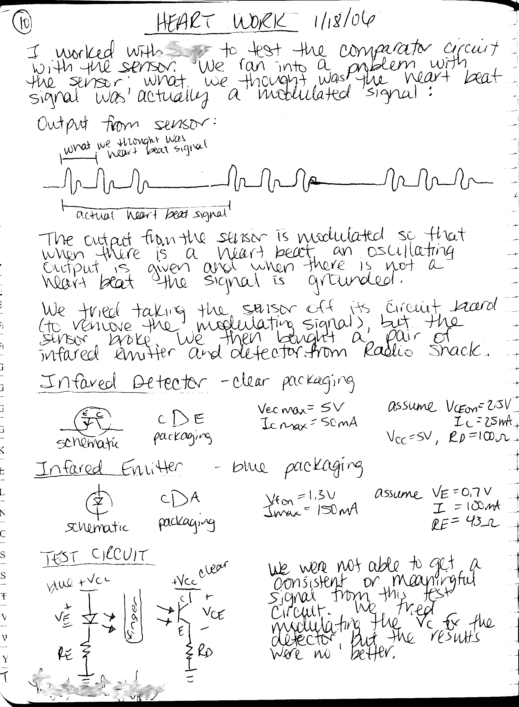
Individual Documentation: Notebook Grading – Example A

Slide 18
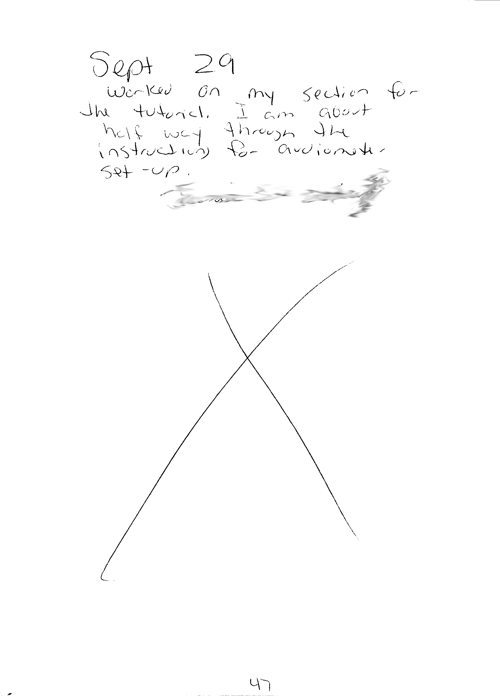
Individual Documentation: Notebook Grading – Example D/F

